Slide 1




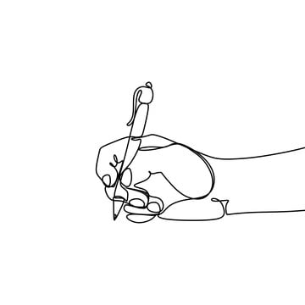


USA Regional Sales Analysis
Project Report
Project By:
Prem Sainath Reddy Mallavalla

Slide 2

ABOUT ME
I am Prem Sainath Reddy. I am currently pursuing a Bachelor's degree in Computer Science and Engineering from
G Pullaiah Engineering college.
In today's data-driven world, I believe that mastering data science techniques will not only enhance my career prospects but also enable me to contribute meaningfully to various industries and societal challenges.

Slide 3

Problem Statement
Sales teams often lack a clear, data-driven understanding of regional performance, making it difficult to identify growth opportunities and optimize resources. This project aims to analyse and visualize regional sales data to uncover trends, evaluate profitability, and support strategic decision-making.

Slide 4

Objectives
✅ Identify top-performing products, sales channels, and regions that drive revenue and profitability
📆 Uncover seasonal trends and detect sales anomalies for better demand forecasting and planning
⚠️ Spot outliers in pricing and margins that may indicate risks or optimization opportunities
📊 Inform pricing, promotion, and market expansion strategies using deep sales and margin analysis

Slide 5
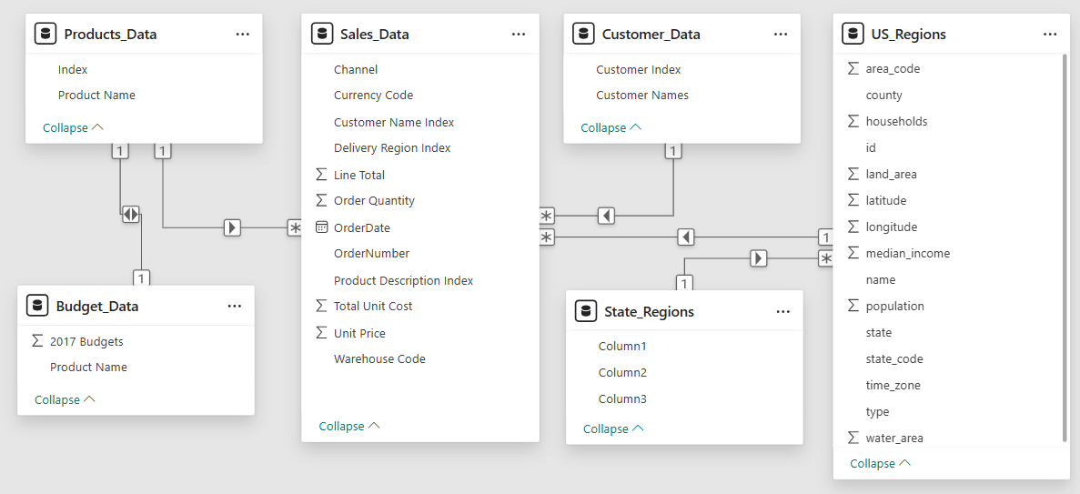
Raw Dataset Structure - Before Processing
Sales, products, budgets, customers, regions, and states were spread across unlinked tables. No relationships were defined initially— Pre-processing was required to clean, normalize, and join them for analysis.

Slide 6
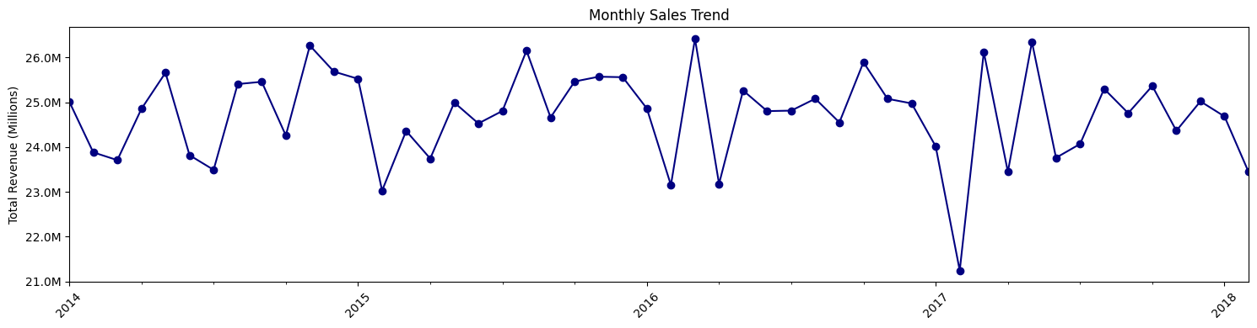
📈Monthly Sales Trend Analysis
📊 Insights
📈 Sales mostly range between $24M and $26M throughout the year.
🌞 Peaks are observed in May–June, showing strong seasonal demand.
❄️ Lows appear in January, likely due to post-holiday slowdown.
⚠️ A sharp drop in early 2017 stands out and may need attention.

Slide 7
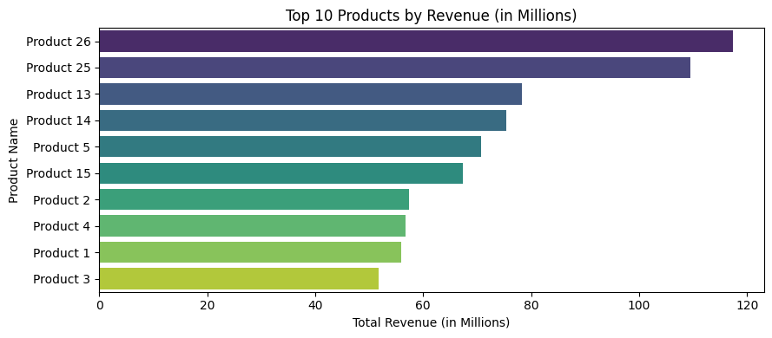
🔝 Top 10 Products by Revenue (in Millions)
📊 Insights
🥇 Product 26 and Product 25 lead the pack with revenues of 💲118M and 💲110M, far ahead of the rest.
📉 A steep drop follows to Product 13 at 💲78M, then a tight group of mid-tier products ranging between 💲68M–💲75M.
🔻 The bottom four products cluster between 💲52M–💲57M, showing similar performance limitations.
🚀 Action Point:
Target growth strategies for mid-tier performers.
Focus on efficiency improvements for the lower performers to boost overall revenue impact.

Slide 8
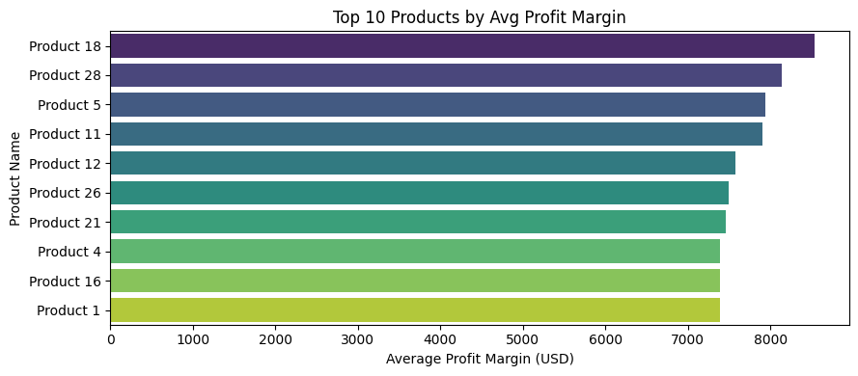
💹 Top 10 Products by Average Profit Margin
📊 Insights
🥇 Products 18 and 28 lead with average profit margins between 💲8.0K–💲8.3K, making them the most profitable items.
🥈 Products 5 and 11 follow closely with margins around 💲7.9K–💲8.0K.
⚖️ Mid-tier performers like Products 12, 26, and 21 show margins in the 💲7.7K–💲7.8K range.
🔻 Bottom performers — Products 4, 16, and 1 — fall slightly lower, between 💲7.4K–💲7.6K.
🚀 Recommendation: Leverage margin strategies from top performers to boost efficiency and profitability across the product line.

Slide 9
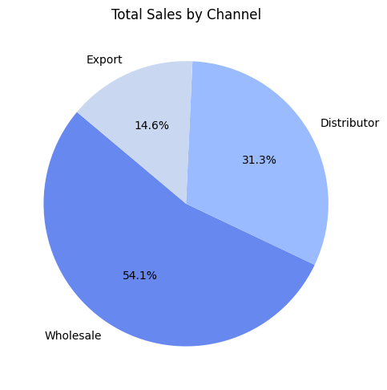
🛍️ Sales by Channel
📊 Insights
🏪 Wholesale dominates with 54% of total sales, showing strong reliance on domestic bulk buyers.
🔄 Distributors contribute around 31%, supporting internal market reach.
🌍 Exports make up only 15%, highlighting an opportunity for international growth.
🚀 Recommendation : To reduce dependency on local channels and minimize risk, focus on expanding export efforts through:
Targeted overseas marketing
Building strategic international partnerships

Slide 10
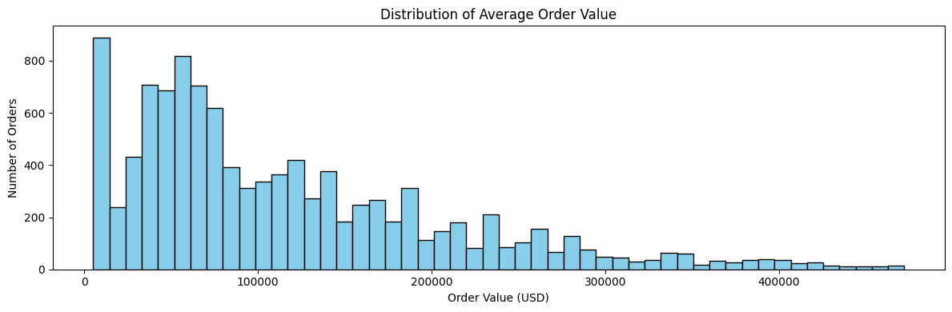
💰 Average Order Value (AOV) Distribution
📊 Insights
Low average order values are frequent.
Distribution is right-skewed (long tail of high-value orders).
Multiple order value clusters exist.
Higher order values are less common.

Slide 11
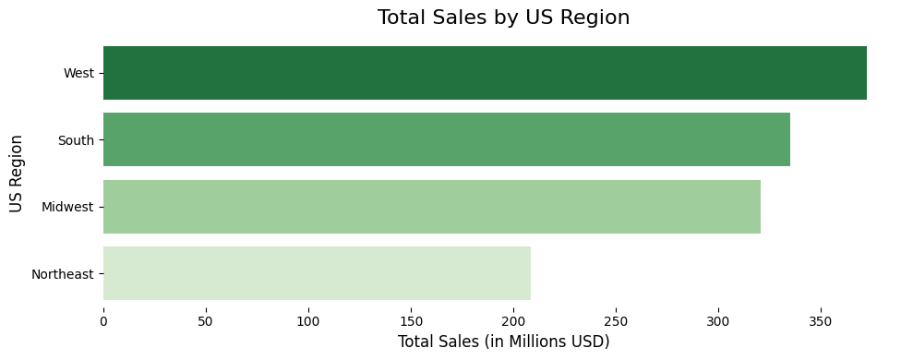
Total Sales by US Region
📊 Insights
🏆 West leads all regions with approximately $360 M in sales (~35% of total), firmly establishing itself as the market leader.
🔁 South and Midwest follow closely, each generating over $320 M (~32%) — reflecting consistent demand and strong regional presence.
🧭 Northeast, with around $210 M (~20%), lags behind — indicating a growth opportunity that remains underutilized.
📈 Actionable Strategy
🎯 Close the Northeast gap by launching targeted local promotions, expanding distribution channels, and developing strategic partnerships.

Slide 12
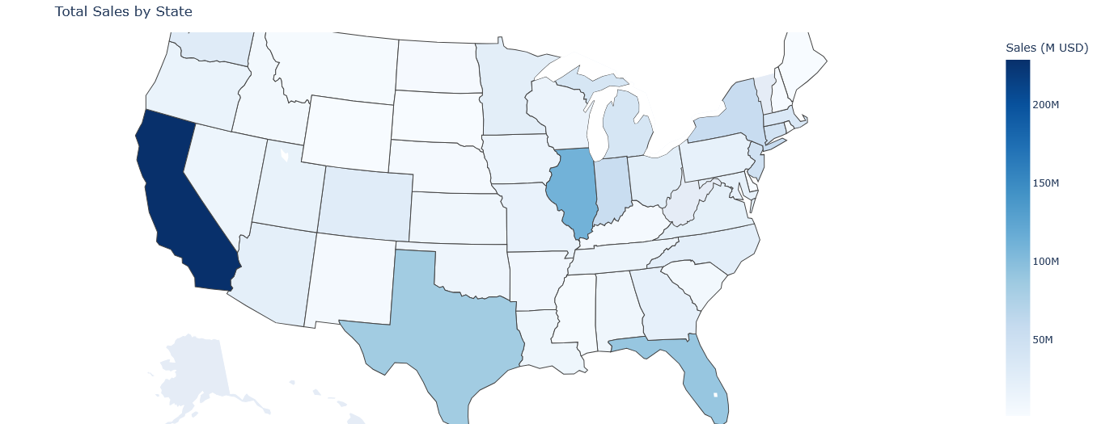
Total Sales by State (Choropleth Map)
📊 Insights
California leads: Highest total sales.
Texas, Florida, Illinois: Significant sales.
Varying sales: Other states show moderate to low sales.
Visual pattern: Higher sales in larger and some coastal states.

Slide 13
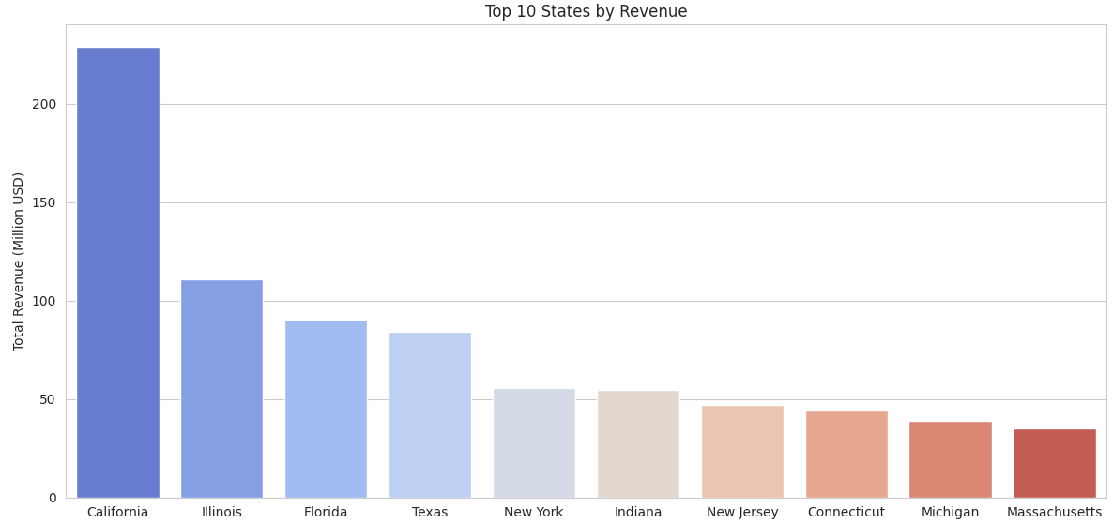
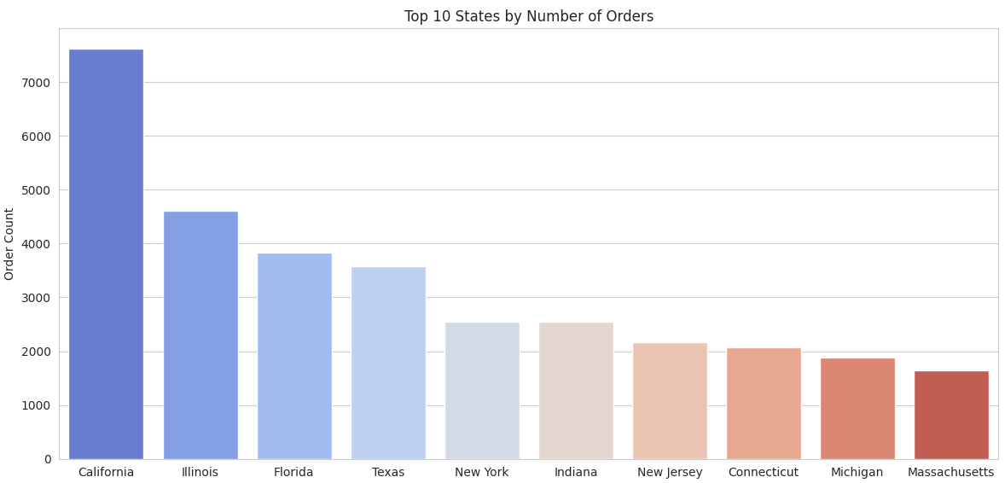
Top 10 States by Revenue and Order Count
📊 Insights Of 💰 Revenue Chart
California is the most valuable market. Mid-tier states like Florida and Texas have growth potential, while lower-tier states need targeted efforts to improve performance.
📊 Insights Of 📦 Order Count
Revenue trends align closely with
order volume — higher orders = higher revenue, suggesting consistent average order values across states.

Slide 14
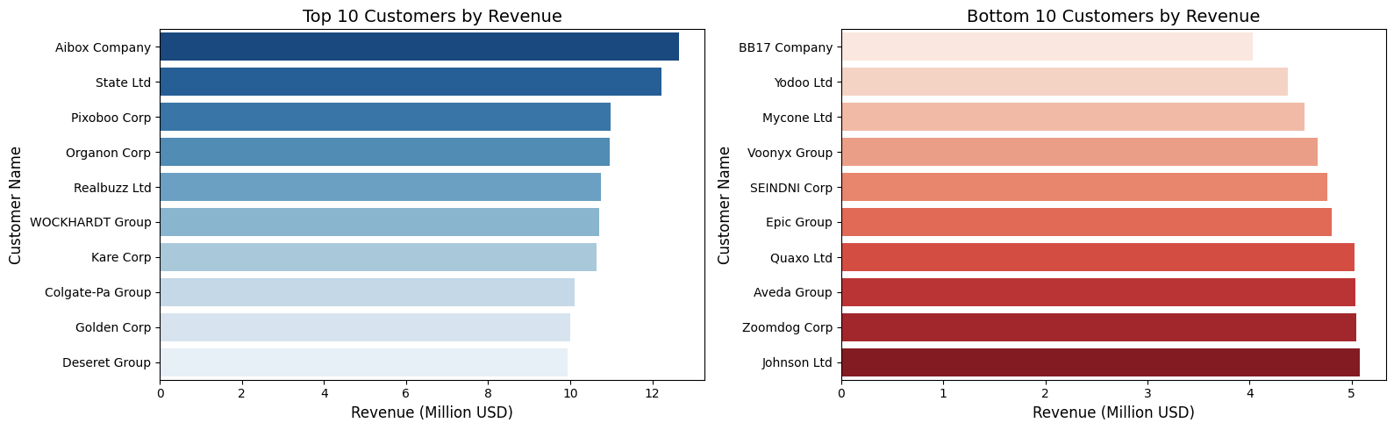
Top 10 States by Revenue and Order Count
📊 Insights
🥇 Aibox Company leads with 💲12.5 M, followed closely by State Ltd at 💲12.2 M. Even the 10th-ranked Deseret Group brings in 💲9.9 M, forming a tightly packed top tier in the 💲10–12 M range.
📉 On the lower end, Johnson Ltd tops the bottom group with 💲5.1 M, while BB17 Company trails at 💲4.1 M — nearly half the revenue of top-tier performers.
🔻 This stark contrast — from over 💲10 M to under 💲5 M — highlights a high revenue concentration in a small number of customers

Slide 15
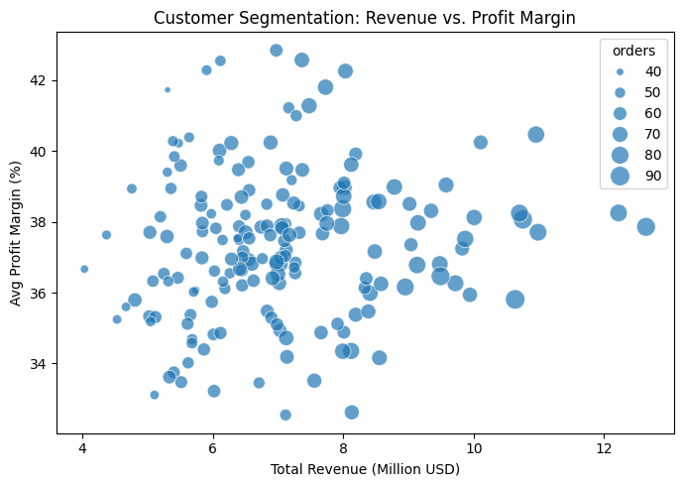
👥 Customer Segmentation: Revenue vs. Profit Margin
📊 Insights
Those Uniform 35–40 % margins confirm strong, consistent pricing and cost control.
>$10 M clients with <36 % margins reveal discounting hotspots—re evaluate large‑account terms.
$6–9 M clients with >40 % margins are high‑value candidates for targeted upsell.

Slide 16
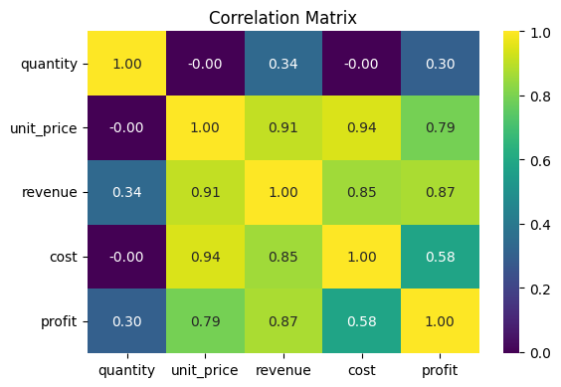
Correlation Heatmap of Numeric Features
📊 Insights
💰 Profit and revenue show a very strong correlation (0.87) — as sales grow, profits typically rise too.
🏷️ Unit price is a major driver:
Strong correlation with revenue (0.91)
Strong correlation with profit (0.79)
Very strong correlation with cost (0.94)
🔁 This shows that pricing decisions directly impact both income and expenses.
💸 Cost is also closely linked to revenue (0.85), but only moderately correlated with profit (0.58) — indicating that profitability can still vary despite higher costs.
📦 Quantity plays a secondary role:
Nearly zero correlation with unit price or cost (~0.00)
Only modest impact on revenue (0.34) and profit (0.30)

Slide 17

Key Insights
Pronounced Seasonality: January revenues average $124 M, dipping to $95 M in April.
SKU(Stock Keeping Units) Concentration: Products 26 & 25 together drive ~25 % of total sales.
Channel Trade‑Off: Wholesale captures 54 % of volume; Export leads with ~38 % average margin.
Geographic Dominance: California alone logs 7.6K orders ($230 M); the West region shows the largest swings.
Aibox Company and State Ltd are the most valuable customers in terms of Revenue.

Slide 18
📈 Strategic Recommendations
🔄 Seasonal Promotions
Launch recovery campaigns in April to offset
post-Q1 dips.
Amplify January promotions to capitalize on strong buying behavior.
📦 SKU Optimization
Double down on top-performing SKUs (#26 & #25).
Re-evaluate or phase out low-margin or underperforming SKUs.
🌐 Channel Expansion
Incentivize Export channels for higher profitability.
Offer volume-based deals in the Wholesale segment to drive bulk sales.
🗺️ Regional Investment
Replicate California’s model of success in high-potential regions.
Increase marketing spend in the Northeast and Midwest to boost reach.
📉 Margin Monitoring
Flag transactions below 80% margin for review.
Deep dive into cost drivers to optimize pricing and profitability.

Slide 19

Dashboard Preview
Dashboard Preview

Slide 20
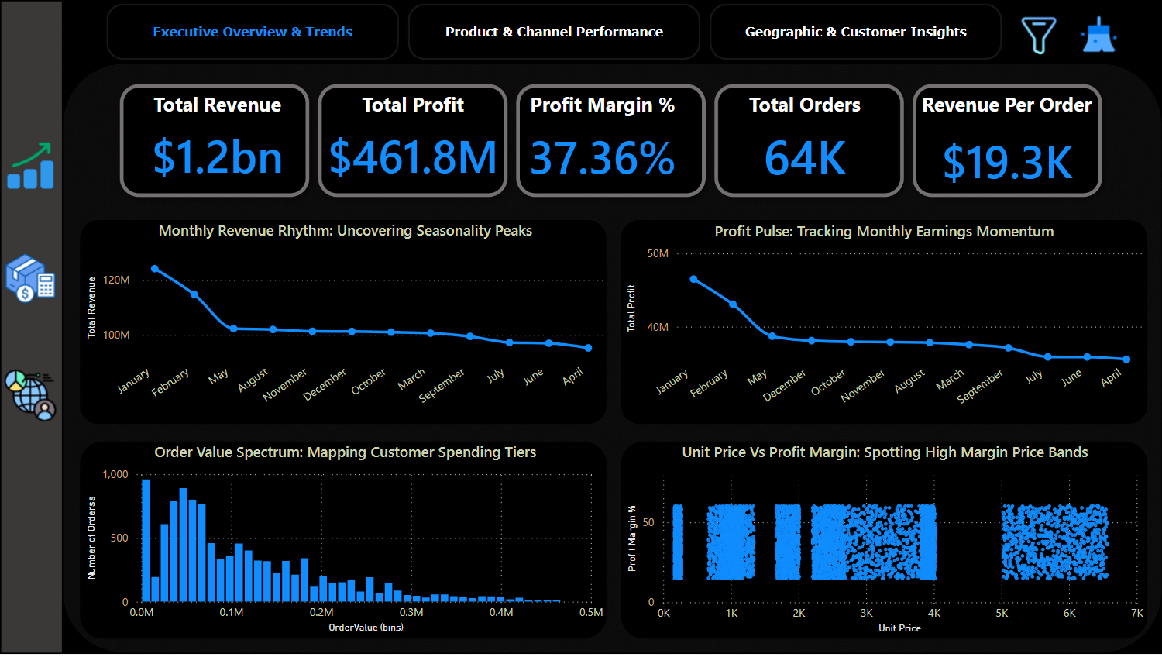
Page 1 - Performance Summary

Slide 21
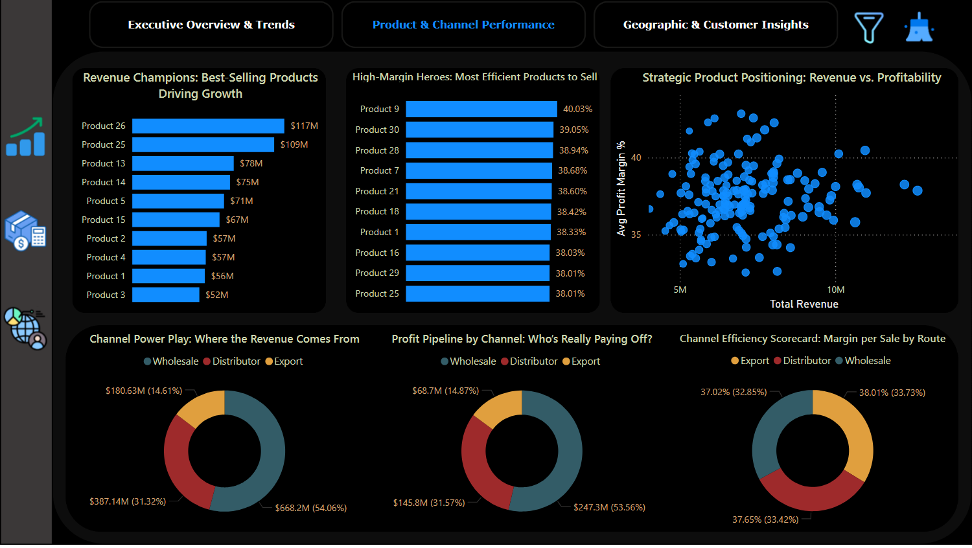
Page 2 - Customer Segmentation

Slide 22
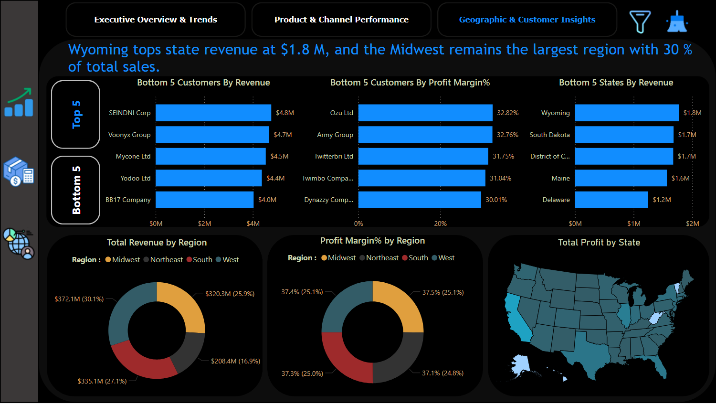
Page 3 - Revenue Scenarios

Slide 23

Conclusions
Completed end‑to‑end EDA and interactive Power BI dashboard, surfacing seasonality, SKU, channel & regional insights.
Insights inform sales policies and operational planning (store & warehouse prep aligned with annual trends).
Stakeholders can self‑serve real‑time analysis and confidently onboard new datasets for additional use cases.

Slide 24


Project By:
Prem Sainath Reddy Mallavalla

